Slide 1

My Shoppe
- One stop for all your shopping needs…

Slide 2
ABOUT THE PROJECT
01
MAJOR REQUIREMENTS
02
TABLE OF CONTENTS
PROJECT GOALS
03
SNEAK PEEK
04
PROJECT STAGES
05
Here you could describe the topic of the section
Here you could describe the topic of the section
Here you could describe the topic of the section
Here you could describe the topic of the section
Here you could describe the topic of the section

Slide 3
My Shoppe
My Shoppe is a cutting-edge ecommerce platform that offers a seamless shopping experience for customers worldwide. With a user-friendly interface and robust features, it simplifies online shopping for both buyers and sellers. From trendy fashion to electronics and more, My Shoppe caters to diverse consumer needs with its wide range of products.

Slide 4
INTRODUCTION
This project aims to design and implementation of a MySQL relational database and NoSQL database for an e-commerce platform called "MyShoppe."
The platform aims to provide a seamless online shopping experience for customers and a reliable platform for vendors to list and sell their products.
The database management system plays a crucial role in ensuring efficient data storage, retrieval, and management of various entities involved in the e-commerce ecosystem
MySQL brings the structure of relational databases, while NoSQL (MongoDB) offers unparalleled flexibility and scalability to meet the demands of modern, data-driven applications.

Slide 5
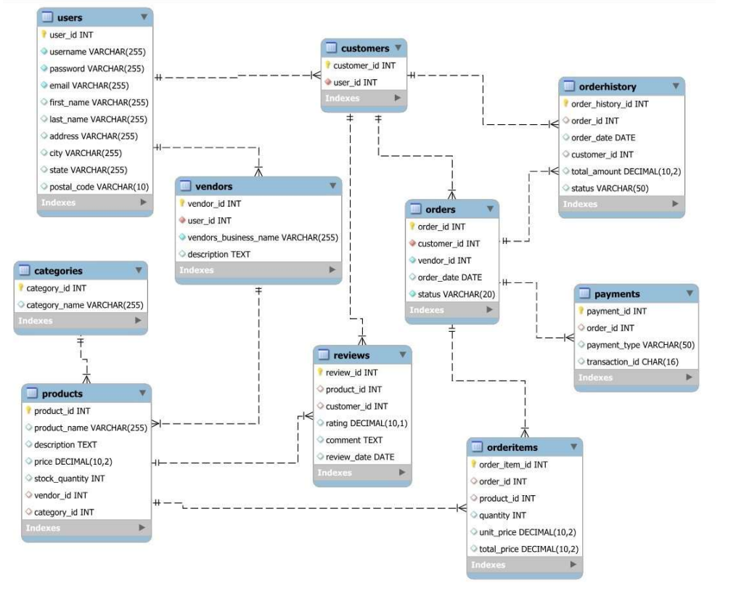
PHASE 1
ER - Diagram

Slide 6
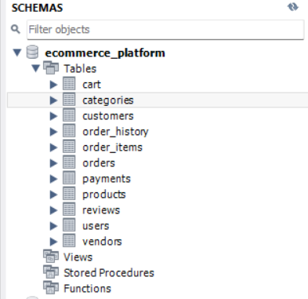
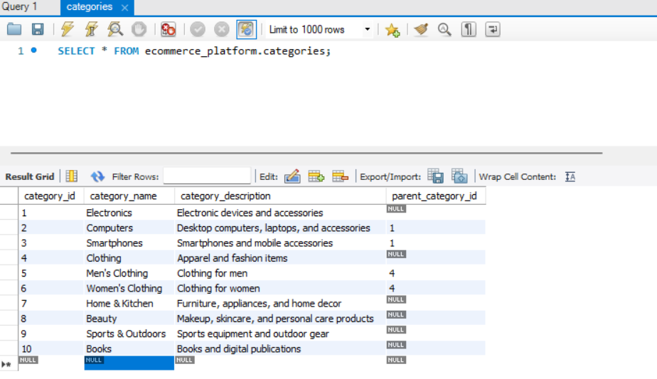
DATABASE SCHEMA
Our Project ‘My Shoppe’ database schema, consists of various tables like 'cart', 'product', 'orders', etc., which have been created using SQL CREATE TABLE statements to define the structure for storing e-commerce data..
Inserted some relevant e-commerce data into the tables using INSERT INTO commands.

Slide 7
Normalization
1. 1NF and 2NF:
- 1NF: Ensures each column contains atomic values and eliminates repeating groups.
- 2NF: Requires non-key attributes to be fully functionally dependent on the entire primary key.
- Example: In the "Orders" and "OrderItems" tables, all attributes in "OrderItems" should be relevant to both OrderItemID and OrderID.
2. 3NF:
- Requires the database to be in 2NF and all attributes to be functionally dependent only on the primary key.
- Example: In the "Users" table, attributes like Username, Email, and Password should directly relate to the primary key (UserID) and not depend on each other.
3. Application:
- Normalization principles applied to reduce data redundancy and improve data integrity.
- Ensures optimal database organization and performance.

Slide 8
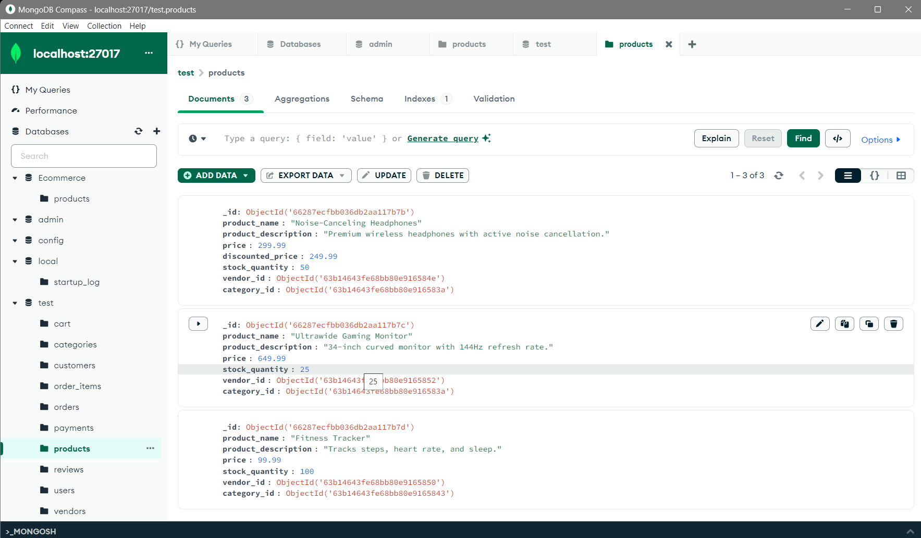
PHASE 2
MONGODB
Flexibility in Schema Design:
- MongoDB allows for flexible schema design, enabling developers to store heterogeneous data types and evolve schemas over time without downtime.
- This flexibility is particularly useful for handling unstructured or semi-structured data, accommodating changes in application requirements without rigid schema constraints.
Scalability and Performance:
- MongoDB is designed for horizontal scalability, distributing data across multiple servers to handle large volumes of reads and writes.
- Its document-oriented model and support for sharding make it well-suited for high-performance applications that require fast data access and scalability.

Slide 9
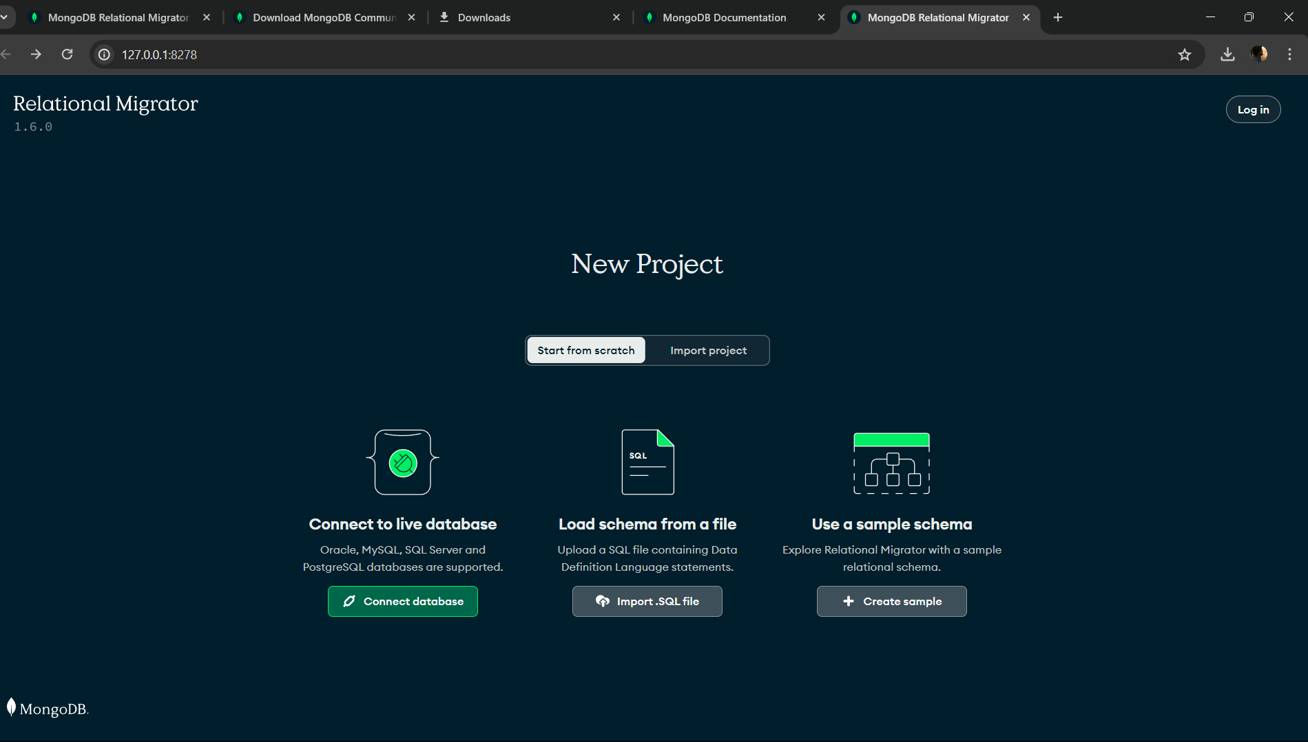
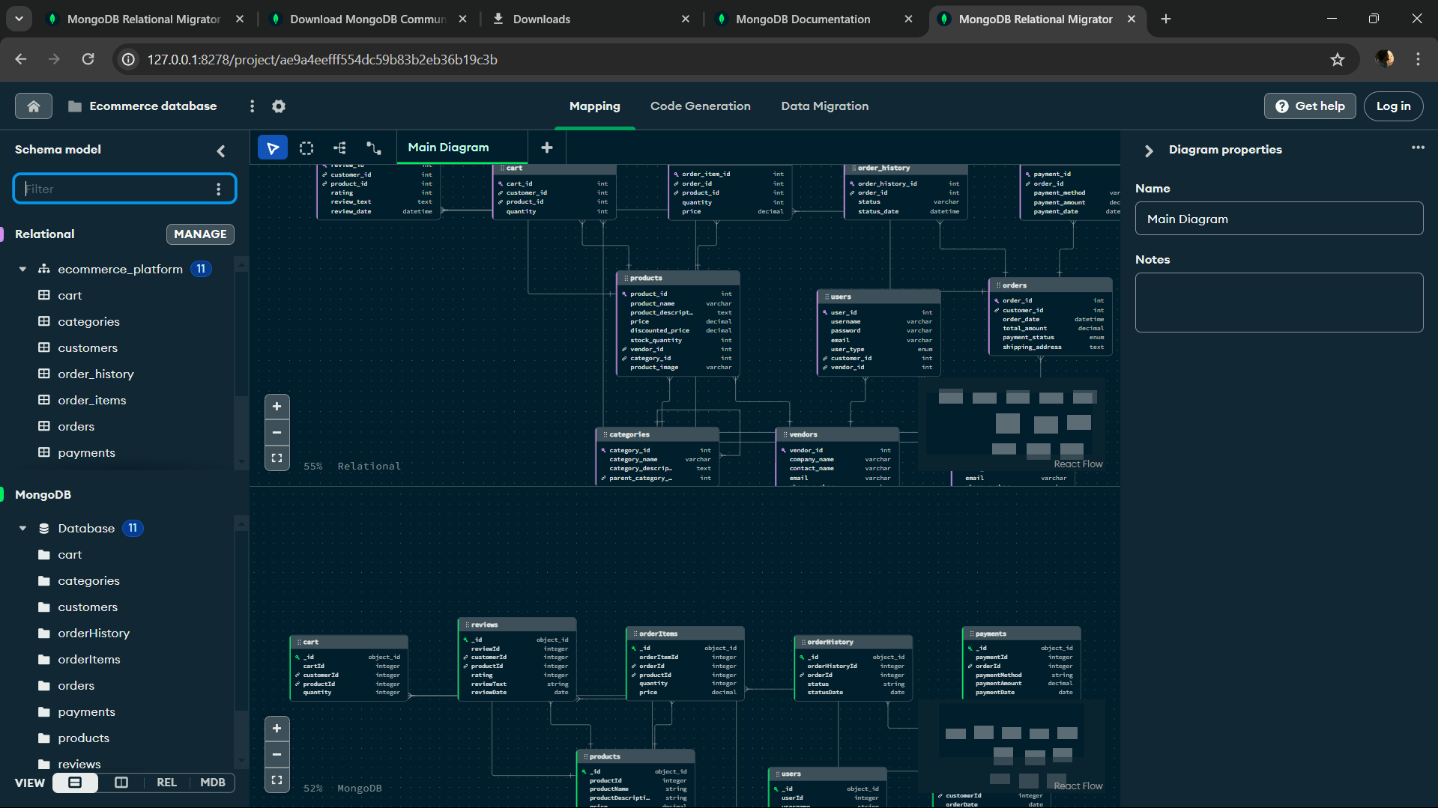
DATA MIGRATION
MongoDB Relational Migrator
- MongoDB Relational Migrator is a tool used to migrate data from relational databases (such as MySQL) to MongoDB.
- It helps streamline the process of transitioning from a relational database environment to a NoSQL database environment like MongoDB by automatically converting schema and data formats.

Slide 10
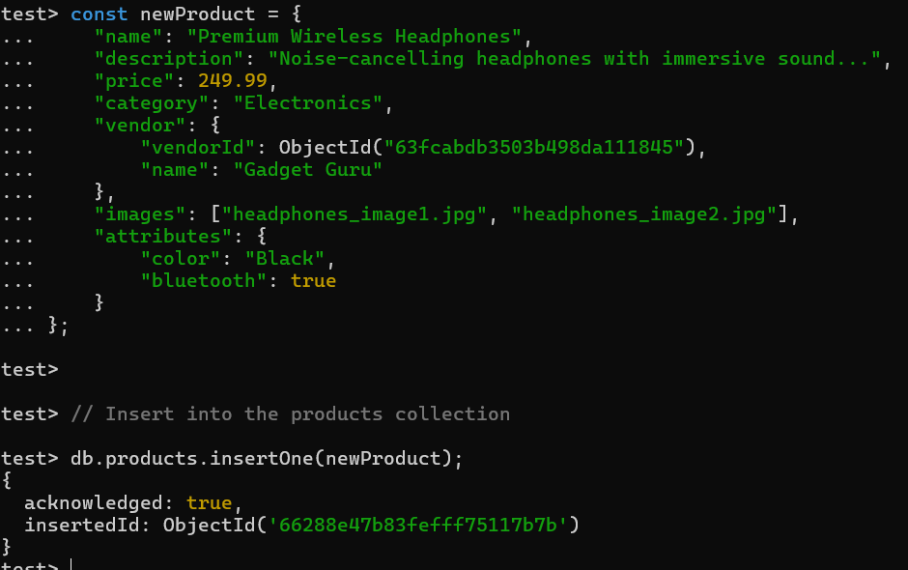
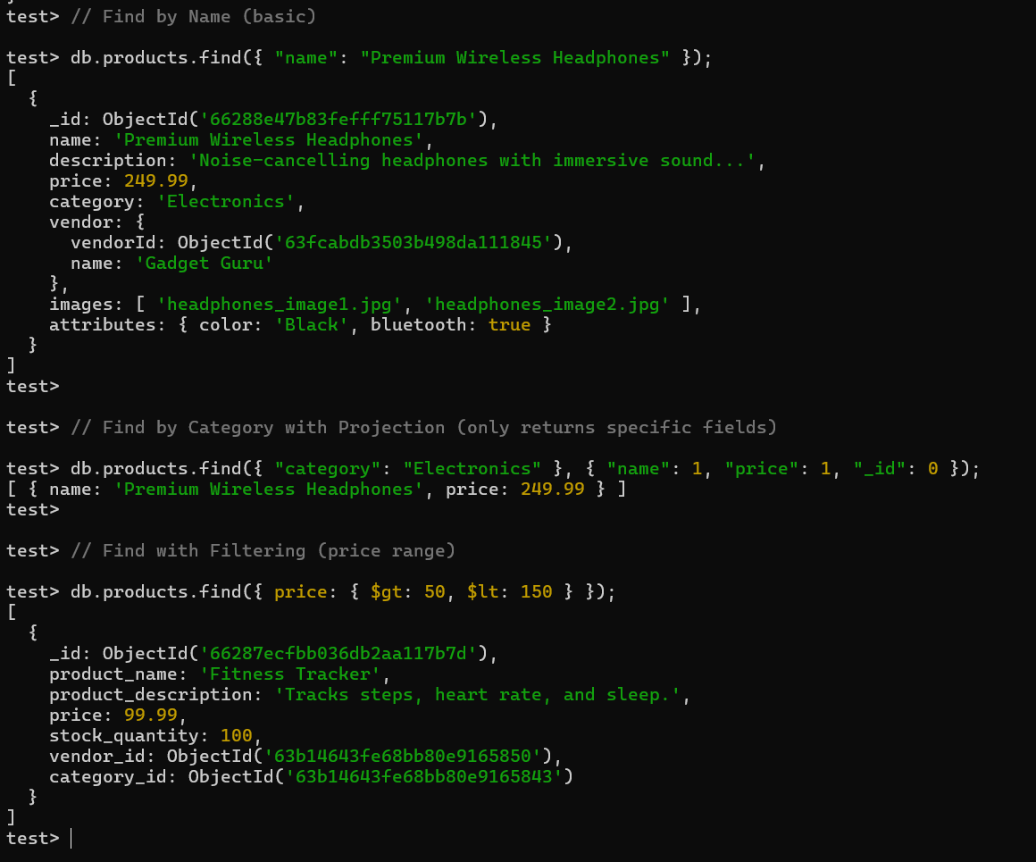
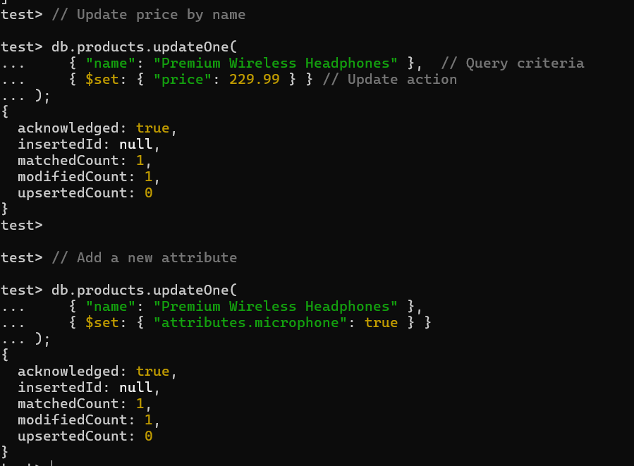
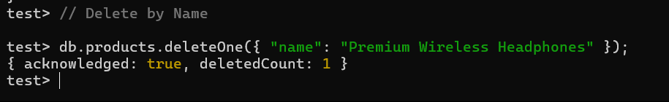
CRUD Operations:
Create:
Read(find):
Update:
Delete:

Slide 11
Data Consistency and Integrity
Synchronization: Define the strategy for keeping relevant data synchronized between MongoDB and MySQL. Will this be real-time, batch updates, or an on-demand approach? Address potential consistency challenges.
Validation: Maintain data validation at the application level for data entering MongoDB.
Define any MongoDB-specific validation rules if applicable.
Transactions: Highlight critical areas (e.g., inventory updates, order placement) where transactions spanning MySQL and MongoDB might be needed. Research strategies for distributed transactions if required.

Slide 12
PLATFORM COMPARISON
Nosql databases like MongoDB provide several advantages over traditional RDBMS, particularly in handling unstructured data, scalability, and flexibility in querying. Below are some MongoDB query examples that illustrate these advantages.
Aggregation:
MongoDB’s aggregation pipeline allows for complex data processing and transformation, whereas RDBMS require multiple SQL joins and subqueries.
TEXT SEARCH
MySQL performs well for simple queries but may have less performance for complex searches or when operating on large datasets due to the nature of relational database structures.
But, MongoDB generally offers better performance and scalability for text searches due to its document-oriented architecture, which can be particularly advantageous when dealing with large collections and unstructured data.

Slide 13
CHALLENGES
Database Design Challenges
1. Shifting from Relational to Document Mindset : Transitioning from MySQL to MongoDB involves adjusting to the document-oriented data model. It requires rethinking how data is structured and grouped within documents to optimize for MongoDB's flexibility.
2. Balancing Denormalization : In MongoDB design, striking a balance between embedding data for speed and referencing data for consistency is crucial. This balance may require iteration as you test different query patterns to optimize performance.
3. Indexing for Optimal Search : MongoDB indexing is powerful but requires careful consideration. Deciding which fields to index to support filtering and sorting in your e-commerce app is essential for efficient search operations.
Data Migration Challenges:
1. Data Transformation : Converting normalized MySQL data into MongoDB documents may involve complex restructuring to ensure data integrity and relevance. Mapping data accurately while maintaining relationships can be challenging.
2. Maintaining Consistency : If you're keeping both MySQL and MongoDB databases up-to-date, ensuring consistency between them is vital. Implementing strategies to manage changes and synchronize data between the two databases is necessary to avoid discrepancies.

Slide 14
Future Scope
1. Personalized Recommendations : Utilize NoSQL's flexibility to analyze customer data and provide tailored product recommendations for enhanced user experience and increased sales.
2. Real-time Analytics : Leverage NoSQL's scalability for real-time inventory management, sales monitoring, and dynamic pricing adjustments to optimize business operations.
3. Geospatial Capabilities : Enhance the platform with geospatial features such as store locators and targeted promotions based on user location, utilizing NoSQL's support for geospatial indexing and querying.
4. Microservices Architecture : Implement a microservices architecture to modularize and scale different components of the platform independently, facilitated by NoSQL's schema flexibility and distributed architecture.
5. AI and Machine Learning Integration : Integrate AI and machine learning algorithms for tasks like product categorization and fraud detection, leveraging NoSQL's scalability to handle large volumes of data efficiently.

Slide 15
CONCLUSION
Phase 1 establishes a solid foundation for the e-commerce platform with a robust MySQL relational database, ensuring data integrity, performance optimization, and support for essential functionalities like user authentication, product management, and order processing.
In Phase 2, MongoDB integration strategically enhances the platform with its flexible data model and advanced search capabilities. This integration will transform product listings and search experiences, enabling rapid and multifaceted search while gracefully scaling with the growing product catalog.
Overall, the e-commerce platform aims to provide a reliable and scalable ecosystem for third-party sellers and deliver an exceptional shopping experience for customers. The combination of MySQL and MongoDB empowers the platform to adapt to the evolving demands of the e-commerce landscape.

